Slide 1
SCHOOL OF INFORMATION SCIENCES, MANIPAL UNIVERSITY
Term Project
PHASE 1 PRESENTATION
Presented by
Anusha A (161046006)
R Ravali (161046013)

Slide 2
OBJECTIVES
To anonymize the placement data of SOIS students since past ten years.
Analyze the data.
Visualization of data.

Slide 3


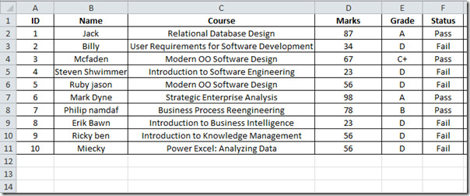



FLOW CHART
Store data
Using Technologies
Anonymize data
Available Data
Database
Python
Hashing
Technique
Visualization of Data
Analysing Data

Slide 4
TECHNOLOGY
We will use python for anonymizing the data.
NoSQL for storing data.

Slide 5
Analysis
We can analyse based on branch, state of domicile.
How curious students are about placements.
Popular courses.
Newly added courses.
Class strength and number of placements.

Slide 6
THANK YOU

